Slide 1
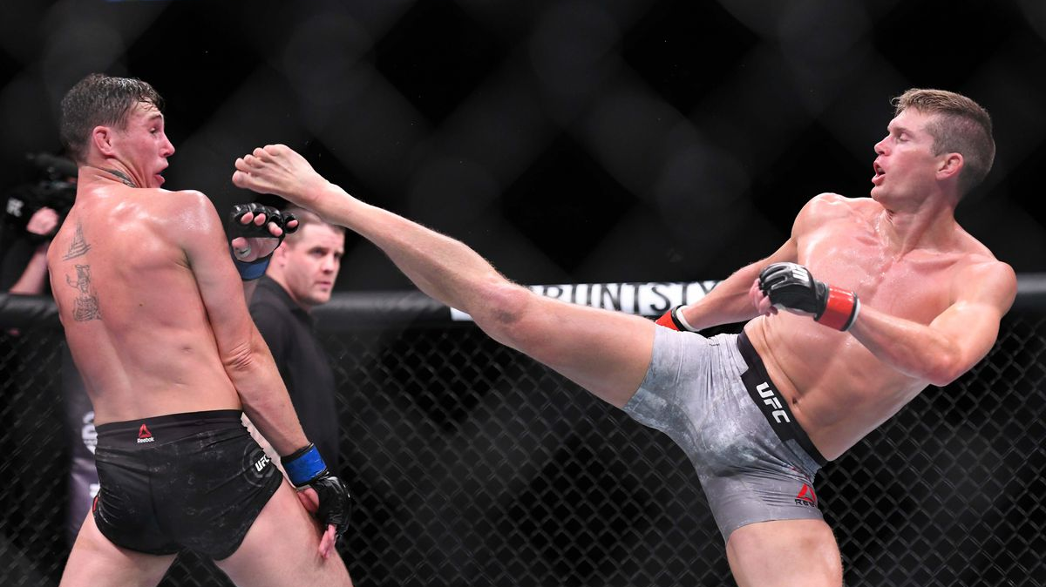
MMA Strike Analysis using computer vision

Slide 2
Overview
Introduction
Part 1 : EDA and Fight Predictor
Dataset: 4000+ fights
EDA, Modelling
Part 2: Computer Vision Analysis of Strikes
Dataset: 144 Images of different strike pose
3400+ array of joint angles
Conclusion and Recommendation
Future Improvements
Notes:
- MMA is one of the fastest growing sport in the world, pushed primiarily by the rapid growth of the UFC
Worth in the range of 7-9 billion dollars
Closer to home, One Championship is gaining traction fast.
With the increasing number of fighters around the world both amateur and pros, motivation is to create a computer vision tool that can assist judges in scoring fights.

Slide 3
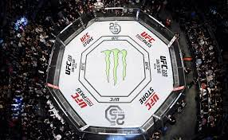

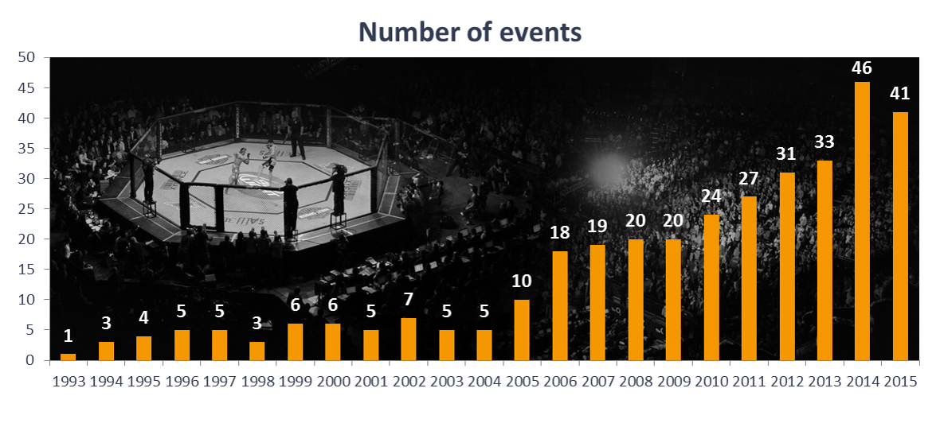
Background Info
USD 7-9 billion
USD 1 billion
Notes:
- MMA is one of the fastest growing sport in the world, pushed primiarily by the rapid growth of the UFC
Worth in the range of 7-9 billion dollars
Closer to home, One Championship is gaining traction fast.
With the increasing number of fighters around the world both amateur and pros, motivation is to create a computer vision tool that can assist judges in scoring fights.
One of the first few sports to open up amidst the pandemic

Slide 4
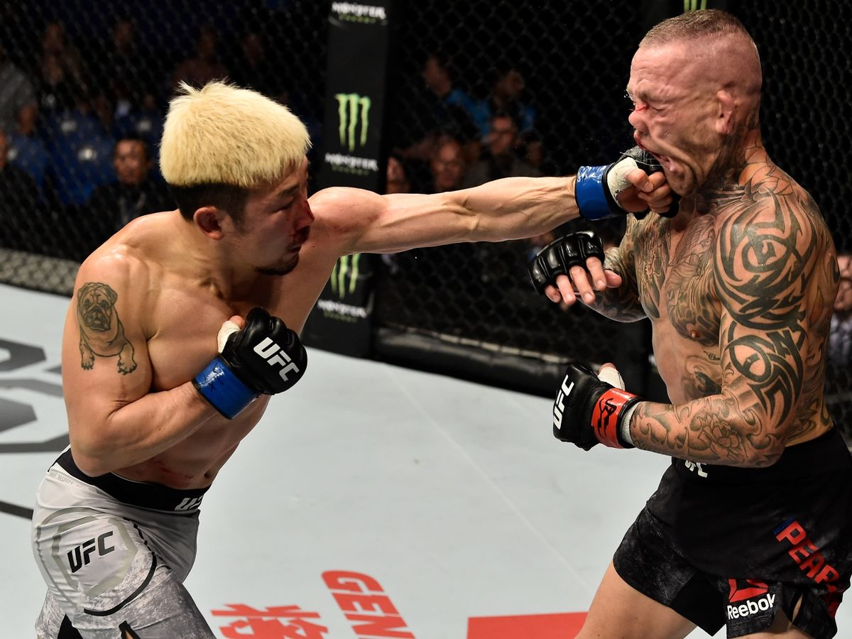
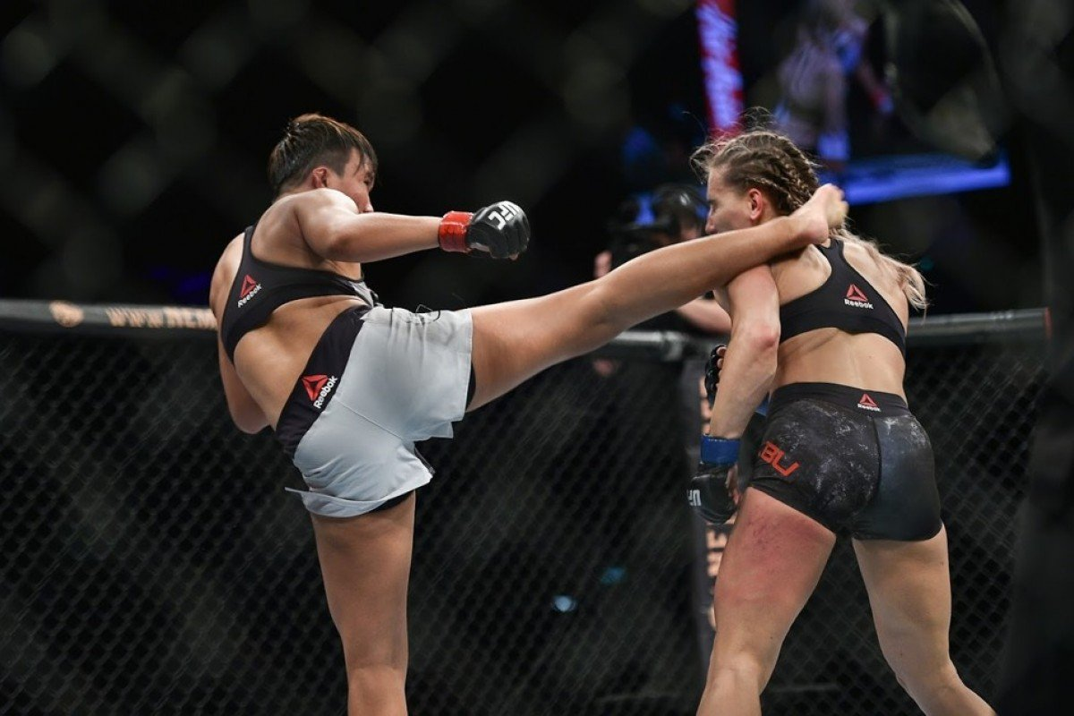
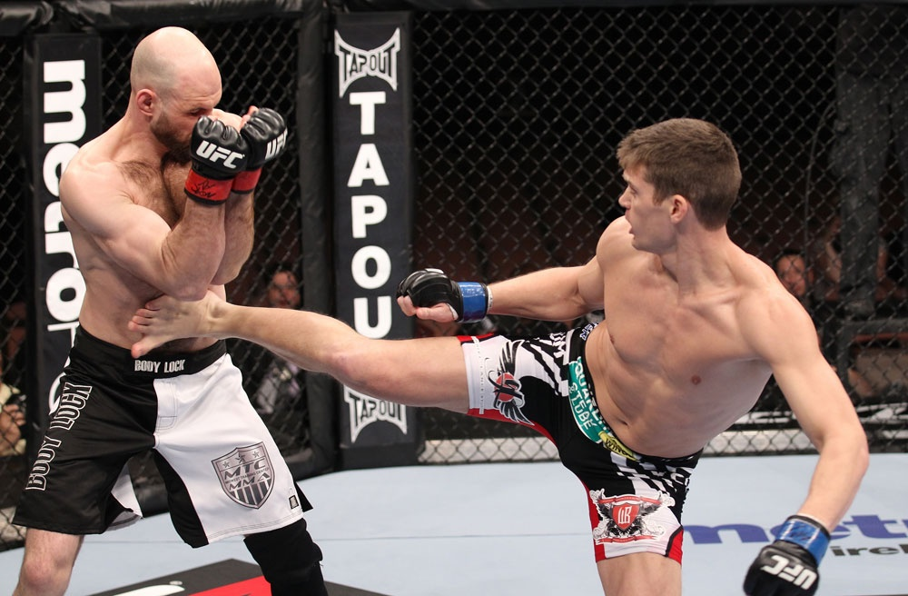
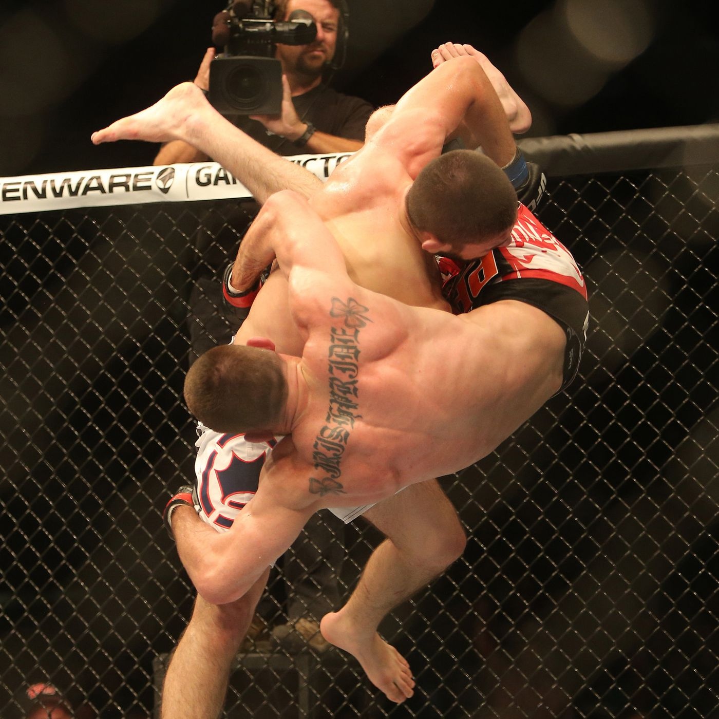
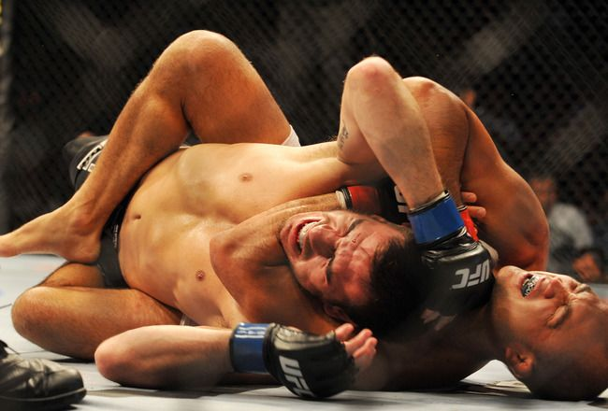
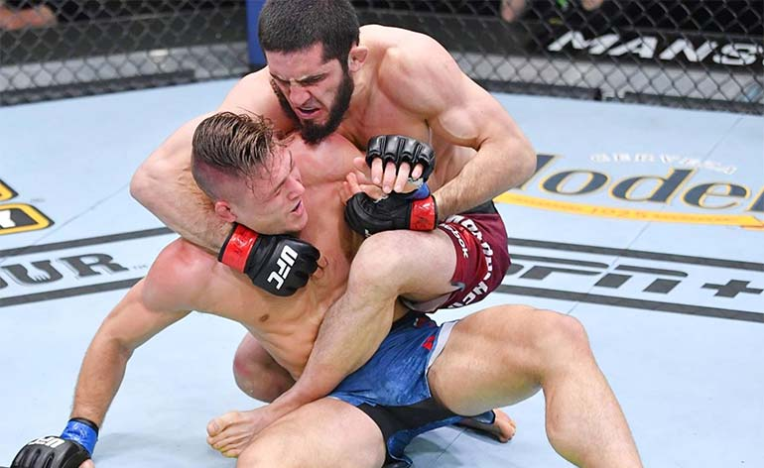
Background A quick introduction on MMA
Multi-disciplinary fighting styles:
Boxing
Kickboxing
Muay Thai
Taekwondo
Karate
Brazilian Jiu-Jitsu (BJJ)
Wrestling
Sambo
Notes:
Kicks are very well utilized in MMA
Some EDA info on kicks and what type of kicks are best at winning or KO power.
79% of fights end in either DEC or KO/TKO, which are mostly dependent on striking abilities.
Proven by the UFC event over the past weekend, where in 4 out of the 5 main fights, the winner had higher significant strikes.
As such, focus of this project will be on analysing strikes.

Slide 5
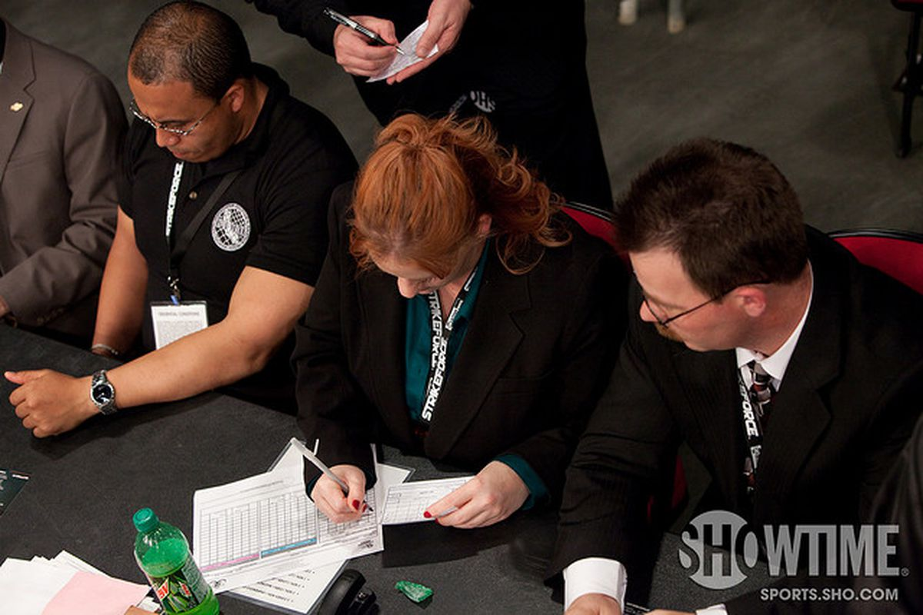
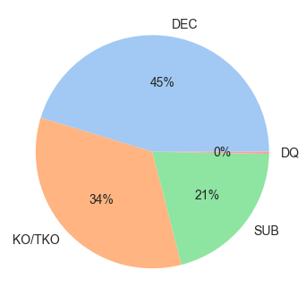
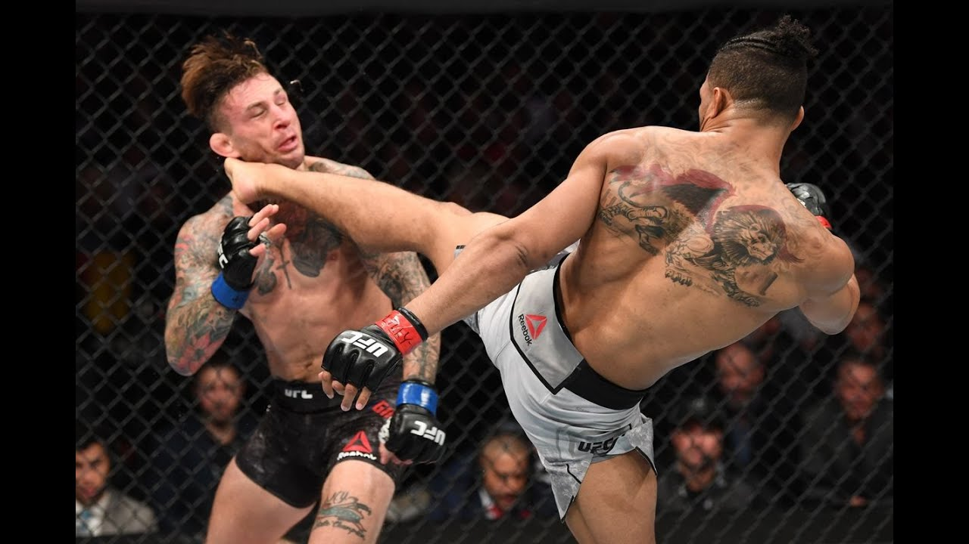
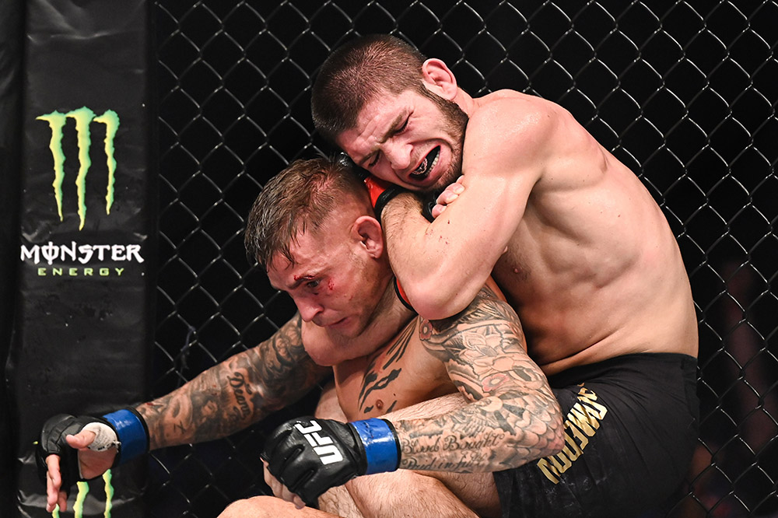
Background A quick introduction on MMA
Notes:
Kicks are very well utilized in MMA
Some EDA info on kicks and what type of kicks are best at winning or KO power.
79% of fights end in either DEC or KO/TKO, which are mostly dependent on striking abilities.
Proven by the UFC event over the past weekend, where in 4 out of the 5 main fights, the winner had higher significant strikes.
As such, focus of this project will be on analysing strikes.

Slide 6
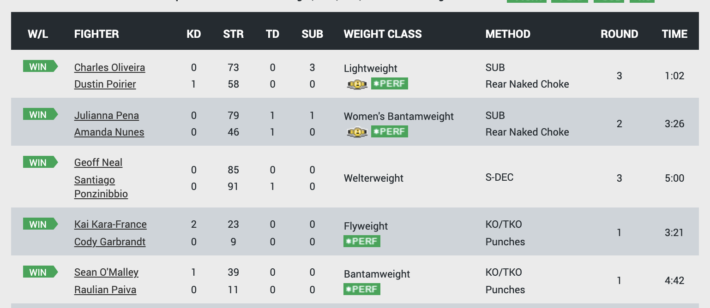
Background info
Notes:
Kicks are very well utilized in MMA
Some EDA info on kicks and what type of kicks are best at winning or KO power.
79% of fights end in either DEC or KO/TKO, which are mostly dependent on striking abilities.
Proven by the UFC event over the past weekend, where in 4 out of the 5 main fights, the winner had higher significant strikes.
As such, focus of this project will be on analysing strikes.

Slide 7
Problem Statement
MMA fights are fast paced and some of the moves may happen too fast for the human eye. As such, judging a fight may be challenging and subjective.
How are fights scored?
Effective striking
Effective grappling
Effective aggressiveness
Control of fighting area
Objective: To create a computer vision tool to assist judges in scoring round and reduce subjectivity in judging fights.
In the form of a strike counter to measure the “effective striking” or ”aggressiveness” of a fighter, that can assist the judges in scoring each round of a fight.
Other potential use: To expand the tool to measure ‘ring control’ and even takedown.
WHY STRIKES?
All fights start on the the feet. As such, strikers will always have the initial advantage over grapplers every round.
Notes:
Effective striking and grappling. Determined by how many legal strikes had been landed, how many takedowns and reversals are executed; submission attempts and position advancements are also taken into consideration.
Effective aggressiveness. Chasing down the opponent with the intention of attacking (p.e., throw a shot, shot for a take-down, …). Moving forward actively (wanting to finish a fight), not passively.
Control of the fighting area. The fighter that is controlling the center of the cage and pushing the opponent outwards (against the cage). The fighter that is dictating the pace and rhythm of the fight and choosing where the fight takes place.

Slide 8
Part 1: Data Cleaning
Features in dataset:
Bio-related features
Age, Height, Reach, Stance
Fight-related features
Strikes: Landed, Absorbed, Defended, Accuracy
Takedown: Landed, Defended, Accuracy
Submission: Attempted
Other features
Weight Class (Flyweight, Lightweight, Heavyweight, etc)
Title Fight (True/False)
Features removed
Round end, Method
Notes:
Features that are not known before a fight are removed, so that can predict future fights.
E.g. round match ended, the method that the fight as won by

Slide 9
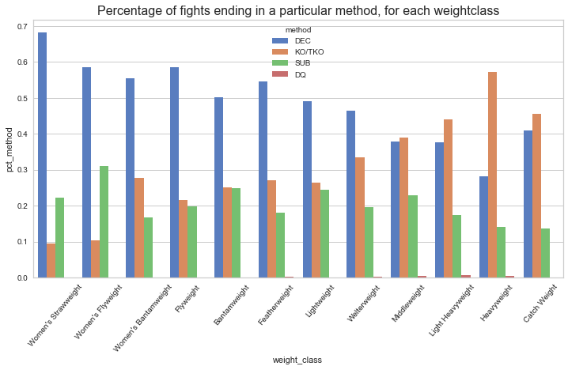
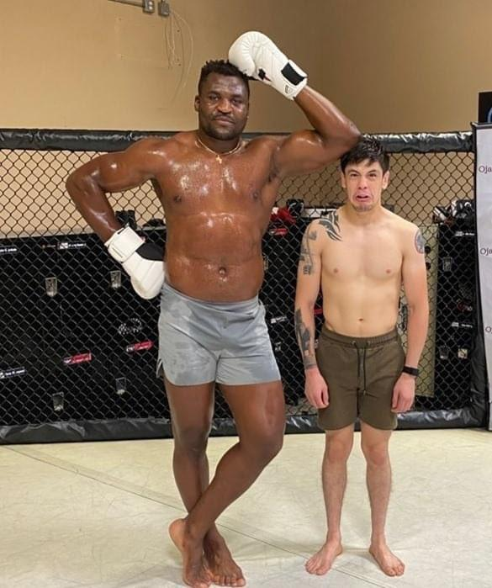
Part 1: EDA
As weight class increases, higher percentage of fights end in KO/TKO
Notes:
As weibht class increase ,higher percentage of fignts end in KO/TKO.
So as you can imagine, the heavyweight fighter on the left would possess greater striking power than the flyweight fighter on the right and therefore have higher chance to Knockout his opponent.

Slide 10
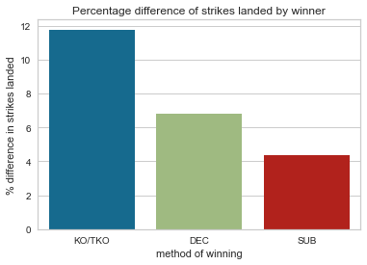
Part 1: EDA
Fighters that win by KO/TKO land more strikes against their opponents than fighters that win by SUB

Slide 11
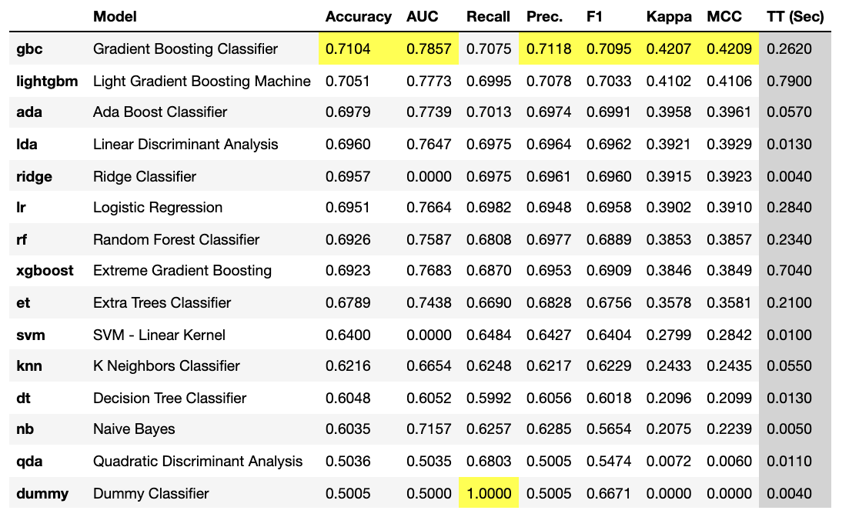
Modelling
Notes:
Gradient Boosting Classifier was selected based on higher scores overall across most classification metrics.

Slide 12
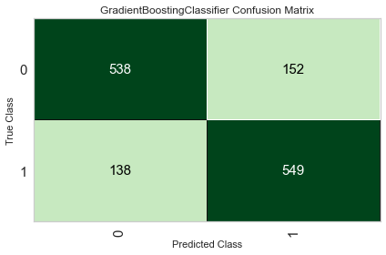
Modelling – Confusion Matrix
Accuracy on Test Set: 78%
Notes:
Gradient Boosting Classifier was selected based on higher scores overall across most classification metrics.

Slide 13
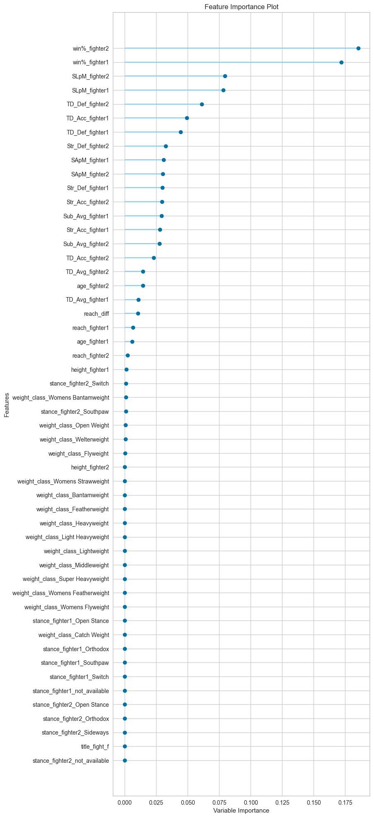
Modelling – Feature Importance
Notes:
Gradient Boosting Classifier was selected based on higher scores overall across most classification metrics.

Slide 14
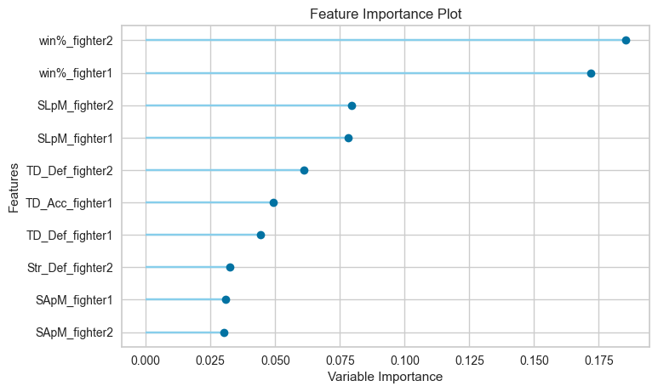
Modelling – Feature Importance
Strikes Landed per Minute
Strikes Defended
Strikes Absorbed per Minute
Notes:
Gradient Boosting Classifier was selected based on higher scores overall across most classification metrics.

Slide 15
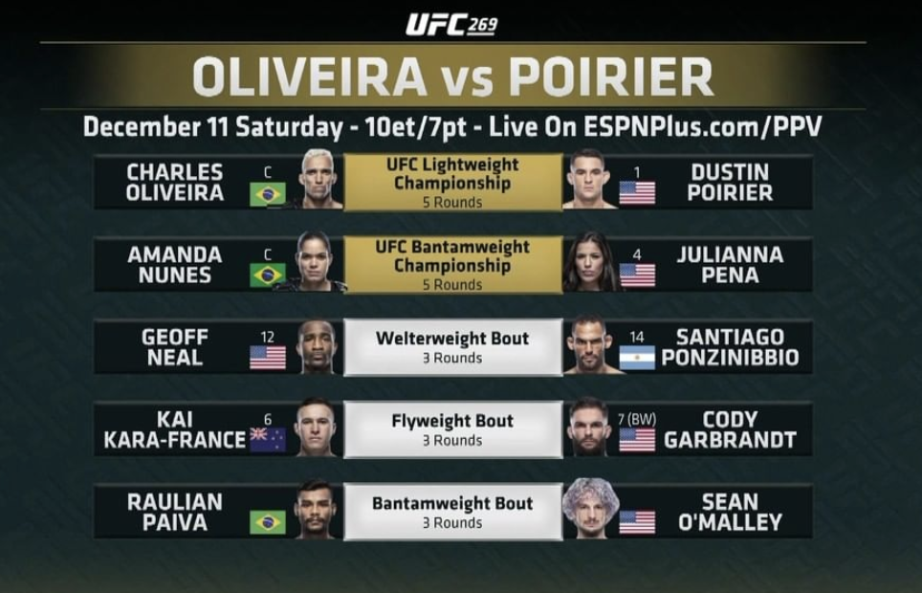


Prediction
Winner
Winner
Winner
Winner
Winner

Slide 16
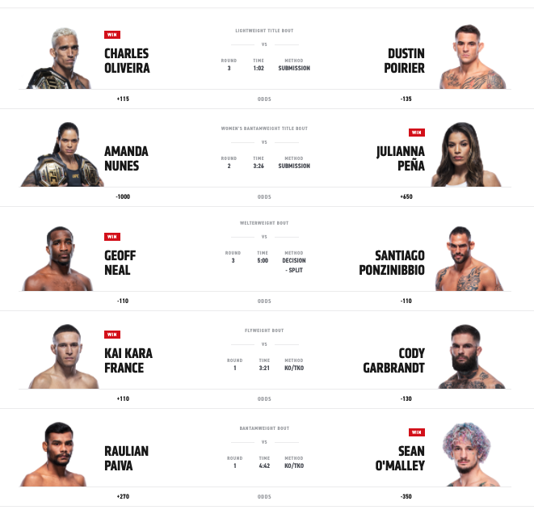

Prediction
Predicted
winner
(83%)
Predicted
winner
(80%)
Predicted
winner
(80%)
Predicted
winner
(60%)
Predicted
winner
(65%)
Notes:
One fight that the model predicted wrongly in particular is the co-main event. It was considered a huge upset, some even calling it the biggest upset in MMA history. This goes to show that the sport of MMA is so unpredictable, that one move can turn the fight around.
As you can see the news all over was talking about how this fight was a huge upset. You can probably do an NLP on this , but yea just goes to show how MMA fights can get unpredictable at times, such is the nature of the sport.

Slide 17
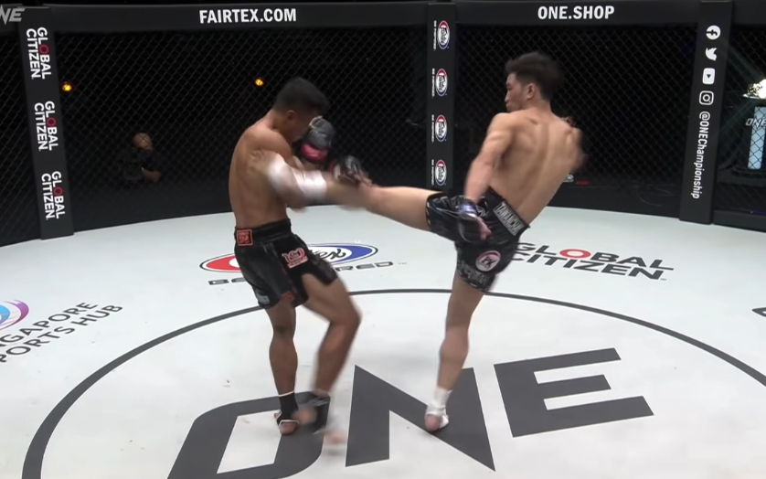
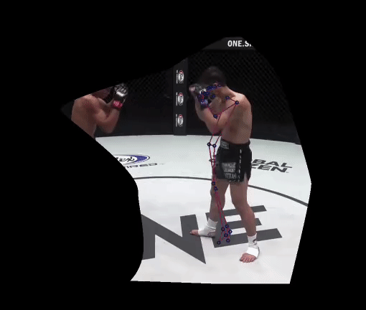
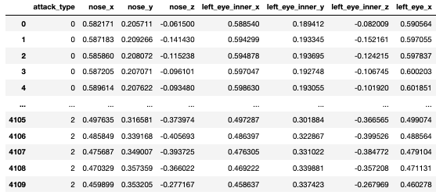




Part 2: Data Collection
Video footage of MMA fights from online sources
Crop out only the relevant fighter and apply pose estimation
Extract pose estimation keypoints into dataframe

Slide 18
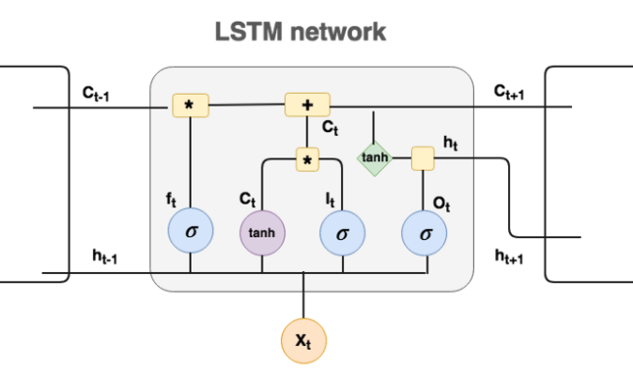
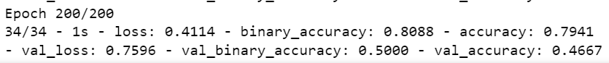
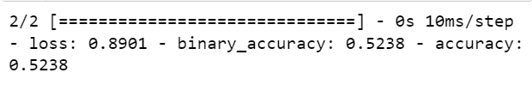
Modelling (LSTM)
Train set
Test set

Slide 19
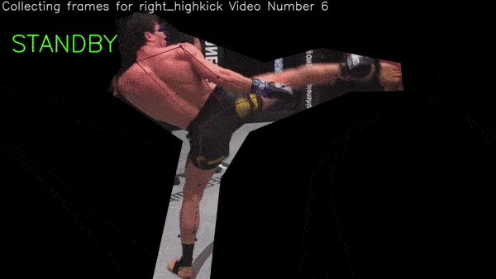
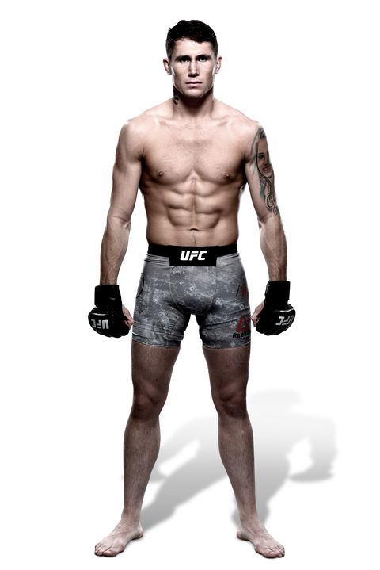

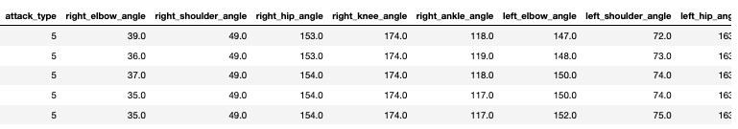
Data Preprocessing
Keypoints were dropped, as it generated too many features, potentially overfitting the model.
10 joints angles were feature engineered.
Only still images of each strike type were used.
Video footage gave too much noise.

Slide 20
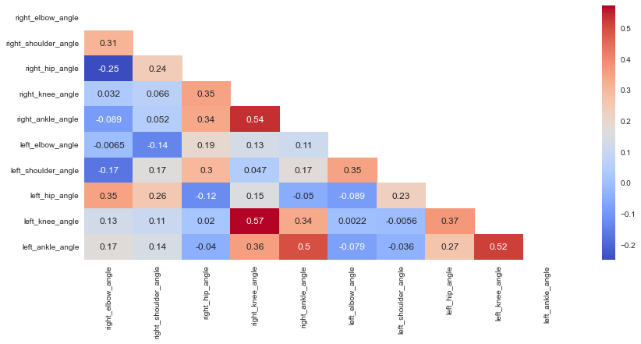
Data Preprocessing

Slide 21
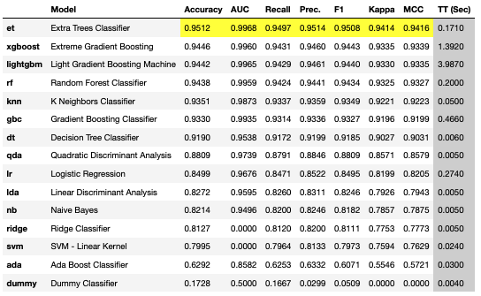
Modelling

Slide 22
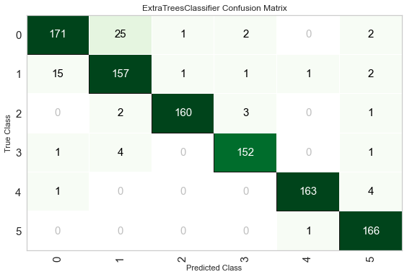
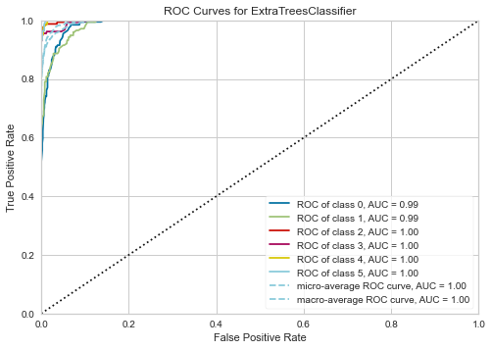
Model Results

Slide 23
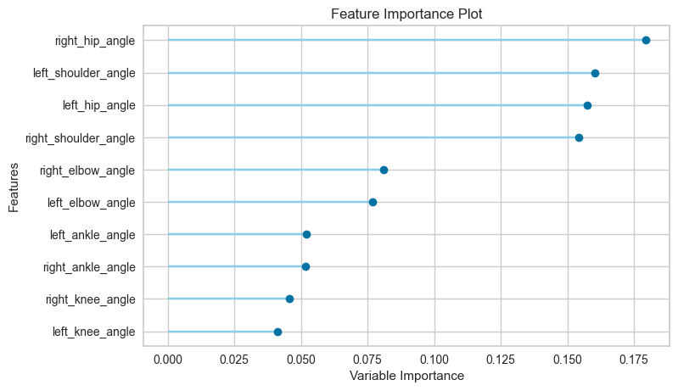
Feature Importance

Slide 24
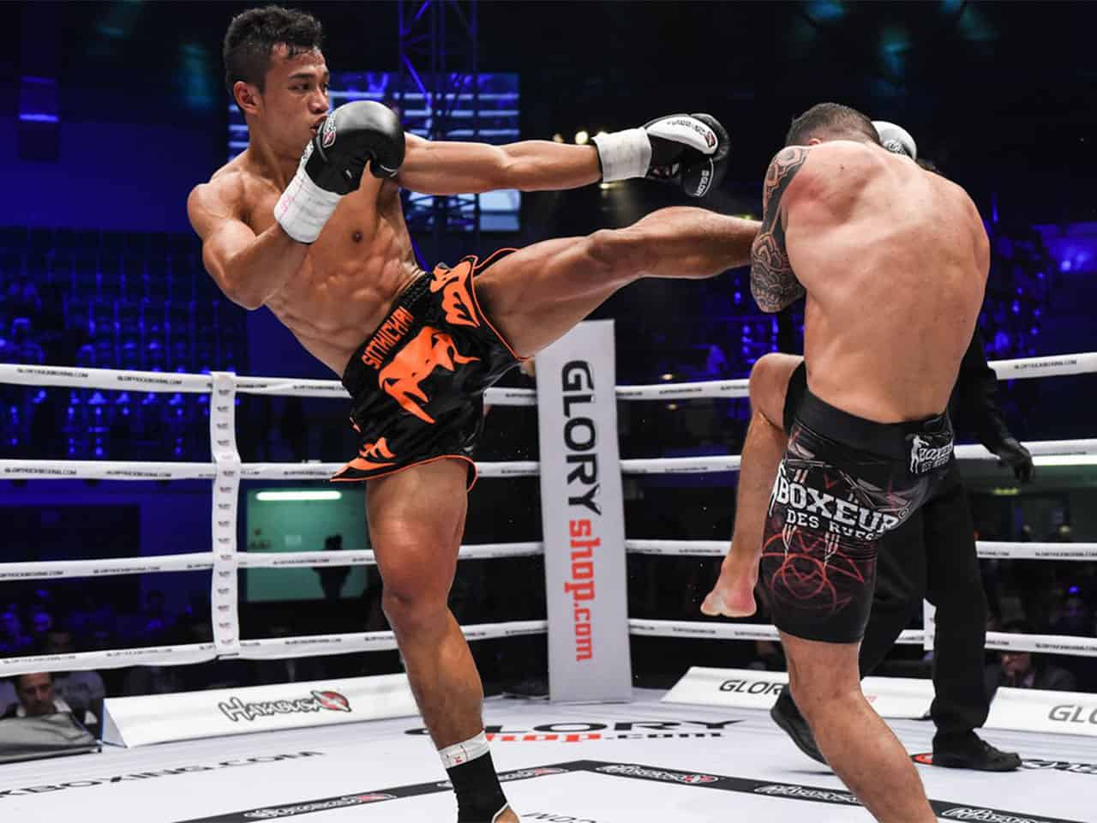
Visualisation of shoulder and hip angles
Left hip angle
Left shoulder angle

Slide 25
ADD IN SAMPLE OF HOW PREDICTION MODEL WORKS ON VIDEO

Slide 26
Conclusion
This is a proof of concept to show the potential of using CV to assist in judging criteria in MMA fights.
With the right video quality, the right camera angles, and support from MMA organisations, this assistive tool can potentially assist judges to make a fairer decision.
CV can also be complemented by other tools such as…

Slide 27
Challenges faced / Limitations
No consistent video angle for better pose estimation result
As such, unable to fixate pose estimation onto the same body
Ideally, to use this on one fixed angle
Fights have minimally 3 people in the ring ; hence hard to dictate the pose estimation onto the person of interest.
Unable to ‘fix’ the detection frame by frame.

Slide 28
Future Improvements
Lots of fighters telegraph before a kick/punch to load up on the power. With better, more accurate Pose Estimation, we could get into the grainier details and potentially predict a kick/punch in-fight.
E.g. before a head kick, fighters tend to bring up their arms up high and chin up. Unfortunately, opencv and mediapipe unable to track small motions like this and the video quality is too poor to track.
Potential use to evaluate safety of fighters before its too late, perhaps by looking at facial recognition tools using CV.
To use pose estimation for predicting moves of an opponent.

Slide 29
Problem Statement What problem are you trying to solve? What larger issues do the problem address? | Outcomes/predictions What predictions are you trying to make? Identify predictors (X variables) and target variables (y) | Data Acquisition Where are you sourcing your data from? Is there enough data? Can we work with it?
Modeling What models are appropriate given the outcomes? | Model Evaluation How can you evaluate your models performance? | Data Preparation What data prep is required to achieve desired outcome?

Slide 30
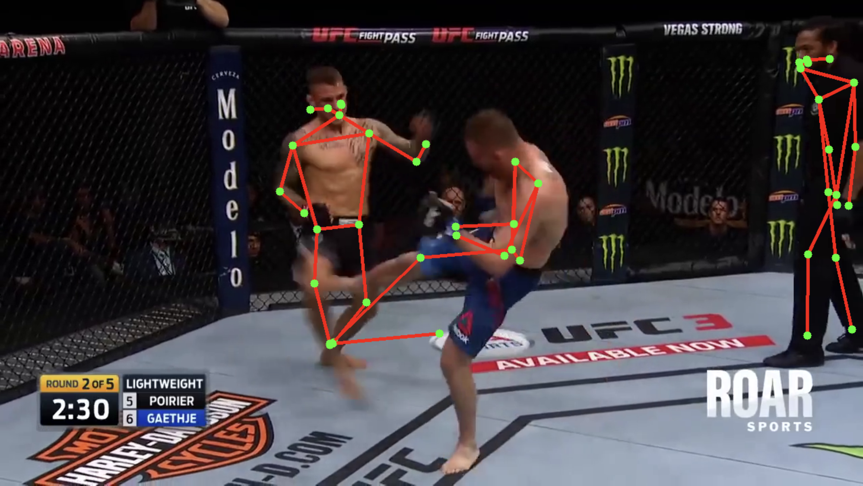
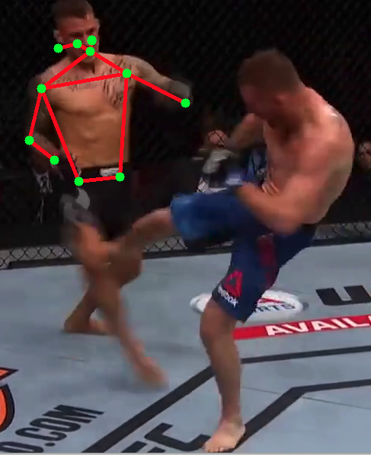
Limitations of multiperson pose estimation
Cons
Unable to distinguish between 2 players that are closeby
Not able to detect kicker

Slide 32
Classical vs Deep Learning Human Pose Estimation (HPE)
Classical:
Swallow machine learning algo
Deep Learning:
CNN (Convolutional NN) works best for HPE
DeepPose
OpenPose (VGG-19) ➔ bottom up approach.
DNN (Deep NN)
Struggles for multi-human ==> too computationally complex
Include distance between 2 man or pose for potential takedown or not. (multiperson)
Angle calculation rather than x,y – coords

Slide 33
Ghost Slide
Problem Statement :
To produce a CV method that quantitatively evaluates MMA strikes (particularly kicks).
To differentiate between low, medium, high kicks and test it’s strength in winning the bout
Pattern recognition?
Does more pressure gives you higher win prob?
MMA stance detection?
Calculate distance between fighters and suggest on whether fighter is within striking zone or takedown zone or
Detect pain on the face (using mediapipe holistic)
Find relation to striking vs win %
Use opencv to improve striking skills for better win %

Slide 34
Modeling
Predicting kicks to KO / win ratio
Predicting angle of kicks to efficacy?
Removing visibility improves prediction on unseen data
To add neutral pose to avoid ‘noise’
Increase epoch
Moving average was done
Create a logic such that the pose estimation position doesn’t jump between fighters

Slide 35
Methods
CNN + LSTM
https://machinelearningmastery.com/cnn-long-short-term-memory-networks/
https://keras.io/examples/vision/conv_lstm/
Using arrays from convolution filter
Mediapipe pose + LSTM
Using arrays from angles and coordinates
Applying moving average to smoothen out

Slide 36
Flow
Get videos of 30fps and extract the arrays using code by Renotte
Try without masking first
Extract angles from these videos and split between 3 types of kicks:
Head kick
Body kick
Low kick
Apply the Pose Estimations and extract the angles
Either using Mediapipe
Extract each frame
Apply data aug
LSTM trained on each frames
Or tf multiperson
Apply the array angles to LSTM model to detect movement
Split train/test set

Slide 37
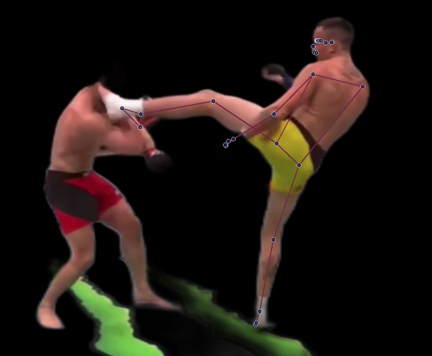
Masking pics

Slide 38
Limitations
Only able to use youtube videos
No dedicated view from one angle
Pose estimations kept jumping around
As a result, not able to fix the object detection to the person as camera angles kept changing throughout the videos

Slide 39
To Do
10 Dec: add 3rd or 4th class
Further refine data processing
Conduct EDA on angles
Test with video of 1s before kick/punch
Try put condition for pose estimation to remain on one person

Slide 40
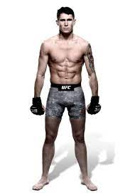
Visualization
Show the keypoints and angles in actual mma fighter

Slide 41
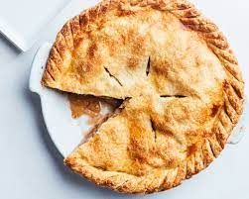
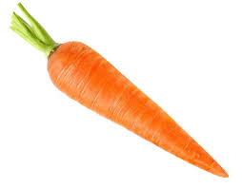
LSTM results
I thought it would make sense for me to use LSTM since the current frame coordinates would highly depend on the previous frames, due to the motion of kick/punch, but results were only accuracy = 0.4
But then…. enter…. Pycaret!

